Slide 1
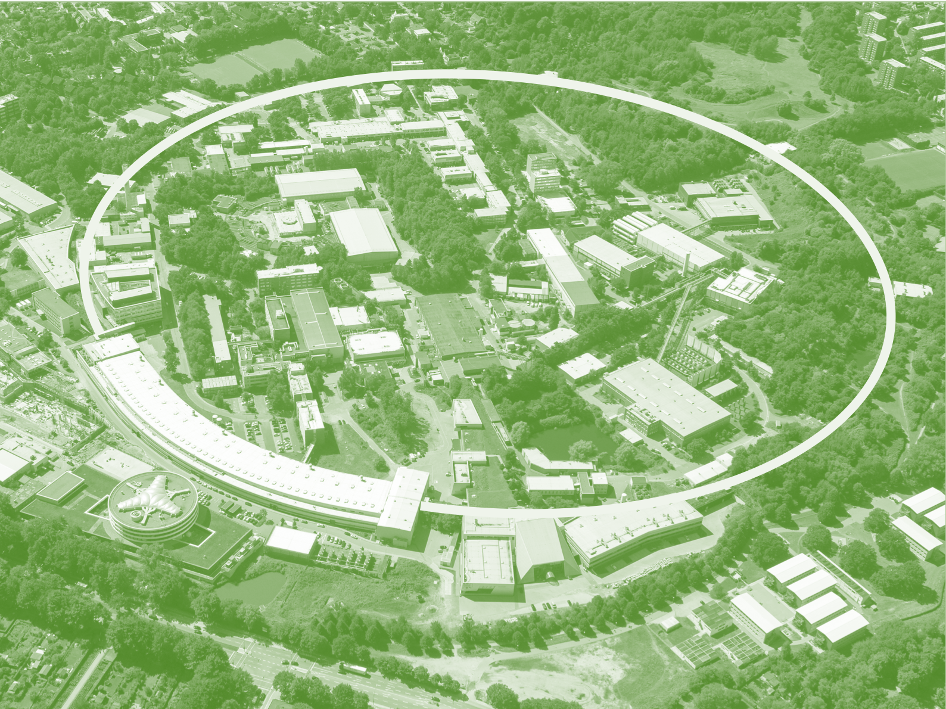
Specific needs of Serial MX in relation to ISPyB Gleb Bourenkov, EMBL Hamburg ISPyB – MXCuBE meeting
Diamond Light Source, 31/01/2018
Notes:
<number>

Slide 2
Serial Synchrotron Crystallography
Too large content removed – sorry!

Slide 3
Serial Synchrotron Crystallography
Serialized helical scans
96-well plates or standard cryo mounts
Typical experiment (plates)
20-50 meshes
1000 helical scans
1000000 images á 1.5 ms exposure
2 hours per experiment
On-the-fly pre processing - diffraction detection
Data processing (integration/scaling) off-line
<number>
08/02/18

Slide 4
Data do go to ISPyB
multiple irregularities preclude automatic post- processing
expert intervention is often required
ISPyB helps (post-) processing enormously

Slide 5
Beamline Parameters
“Focusing Optics”
lucking structured data for X-ray mirrors and X-ray lenses
Lucking apertures
<number>
08/02/2018

Slide 6
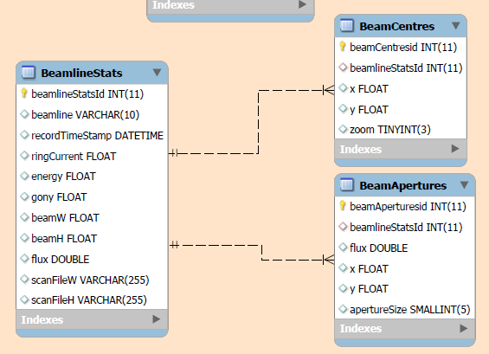
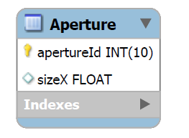
Re-use one of existing Aperture tables?
<number>
08/02/2018

Slide 7
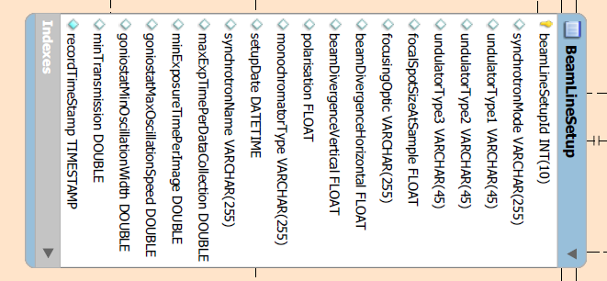
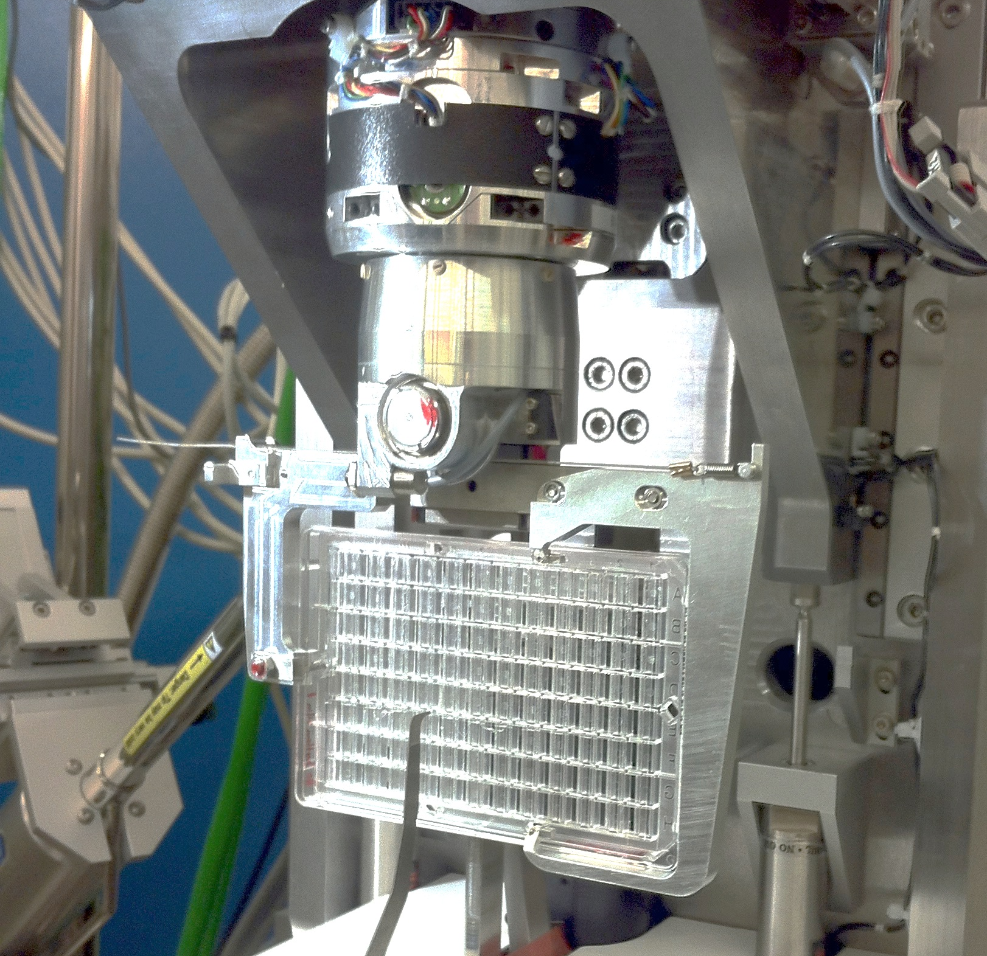
The notion of Goniometer seems missing in ISPyB
<number>
08/02/2018

Slide 8
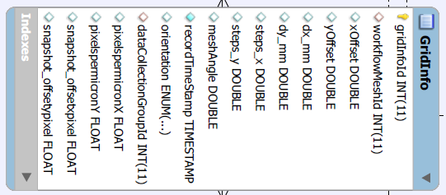
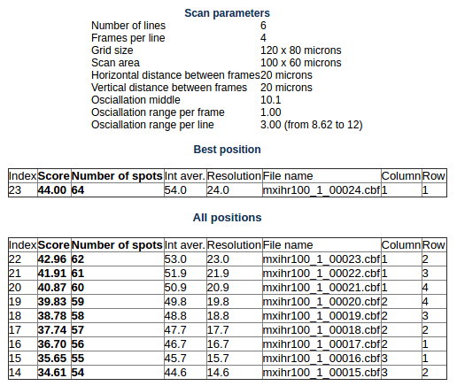
Experiment parameters
partial mesh scan data are present in DataCollection/GridInfo table
not found in EXI, used to be some html file displayed in ispyb–ui
<number>
08/02/2018
Notes:
<number>

Slide 9
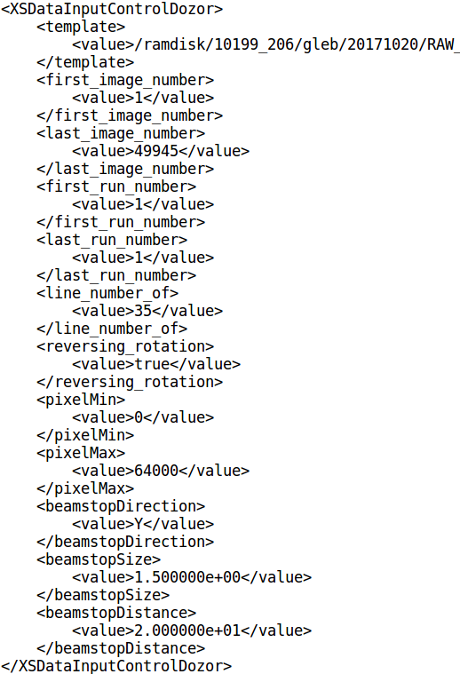
Data for downstream processing
need data to recover geometrical
connectivity between frames
this can not be accomplished via detector & frame headers & etc.
currently: re-using EDNA/DOZOR
xml inputs
beamstop schema (DOZOR)
<number>
08/02/2018

Slide 10
DataCollection table, #98 elements
dataCollectionId dataCollectionGroupId strategySubWedgeOrigId detectorId blSubSampleId dataCollectionNumber startTime endTime runStatus axisStart axisEnd axisRange overlap numberOfImages startImageNumber numberOfPasses exposureTime imageDirectory imagePrefix imageSuffix fileTemplate wavelength resolution detectorDistance xBeam | yBeam xBeamPix yBeamPix comments printableForReport slitGapVertical slitGapHorizontal transmission synchrotronMode xtalSnapshotFullPath1 xtalSnapshotFullPath2 xtalSnapshotFullPath3 xtalSnapshotFullPath4 rotationAxis phiStart kappaStart omegaStart resolutionAtCorner detector2Theta undulatorGap1 undulatorGap2 undulatorGap3 beamSizeAtSampleX beamSizeAtSampleY centeringMethod | averageTemperature actualCenteringPosition beamShape flux flux_end totalAbsorbedDose bestWilsonPlotPath imageQualityIndicatorsPlotPath imageQualityIndicatorsCSVPath blSampleId sessionId experimentType crystalClass chiStart detectorMode actualSampleBarcode actualSampleSlotInContainer actualContainerBarcode actualContainerSlotInSC positionId focalSpotSizeAtSampleX polarisation focalSpotSizeAtSampleY apertureId screeningOrigId | processedDataFile datFullPath magnification binning particleDiameter boxSize_CTF minResolution minDefocus maxDefocus defocusStepSize amountAstigmatism extractSize bgRadius voltage objAperture c1aperture c2aperture c3aperture c1lens c2lens c3lens
<number>
08/02/2018

Slide 11
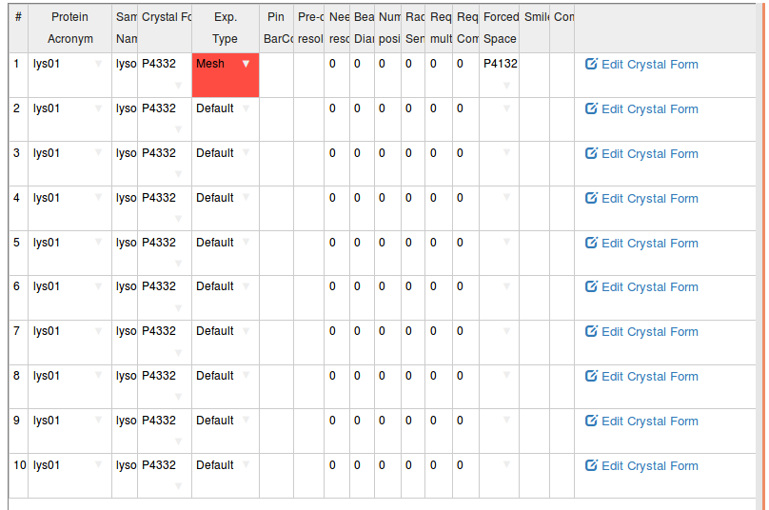
Diffraction plan
+ shipment , loading, etc. generally for plates
<number>
08/02/2018

Slide 12
Summary
Experimentally, SSX is close to maturation
Certain similarity with related methods (Mesh Workflows) made partial ISPyB implementation straight forward
Full implementation requires significant revision of both the database and interfaces
We need to learn a pathway for such revisions
<number>
08/02/2018

Slide 13
People involved
Ivars Karpics (MXCuBE, ISPyB)
Marina Nikolova (Data Acquisition)
Johanna Hakanpää (Applications)
Thomas Schneider
<number>
08/02/2018

